Slide 1
Measurements & Calculations
Chapter 2
Why it Matters

Slide 2
Skipping 2.1

Slide 3
Objectives 2.2
I can……
Distinguish between a quantity, a unit, and a measurement standard.
Name and use SI units for length, mass, time, volume, and density.
Distinguish between mass and weight.
Perform density calculations.
Transform a statement of equality into a conversion factor.

Slide 4
SI Measurement
Scientists all over the world have agreed on a single measurement system called Le Système International d’Unités, abbreviated SI.
SI has seven base units
  most other units are derived from these seven

Slide 5
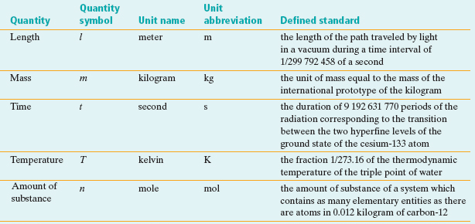
SI Base Units

Slide 6
The METRIC System
This is the system we will be using throughout Chemistry!

Slide 7
The Metric System
Mega
Base
unit
kilo
hecto
deca
deci
centi
milli
Micro
M
k
h
da
g,m,L
d
c
m
µ
10⁶
1000
100
10
1
.1
.01
.001
10⁻⁶
Mg
km
hL
dag
dg
cm
mL
µg
= 10 grams
1000 mL = 1 L
= 100 liters
100 cm = 1 m
= 1,000 meters
10 dg = 1 g
= 1,000,000 grams
1,000,000 ug = 1 g

Slide 8
Metric System (continued)
Create a mnemonic device to help you remember the order of the metric system.
King Henry Died By Drinking Chocolate Milk

Slide 9
Sample Problem
Express a mass of 5.712 grams in milligrams
Given: 5.712 g
Unknown: mass in mg
Solution: mg
1 g = 1000 m
Possible conversion factors:

Slide 10
Sample Problem
Express a mass of 5.712 grams in kilograms
Given: 5.712 g
Unknown: mass in kg
Solution: kg
1000 g = 1 k
Possible conversion factors:

Slide 11
Practice Problems:
8.25 grams = _________kilograms?
1000 g = 1 kg
8.25 g x 1 kg = 0.00825 kg
1000 g
2. 677 decagrams = __________grams?
10 g = 1 dag
677 dag x 10 g = 6770 g
1dag

Slide 12
Practice Problems:
3. 21.0 meters = ___________decimeters?
10 dm = 1 m
21.0 m x 10 dm = 210.0 dm
1 m
4. 4563 milligrams = _________grams?
1000 mg = 1 g
4563 mg x 1 g = 4.563 g
1000 mg

Slide 13
Practice Problems:
5. 0.251 kilometers = __________centimeters?
0.251 km x 100,000 cm = 25,100cm
1 km
6. 254 liters = ___________decaliters?
254 L x 1 daL = 25.4 daL
10 L

Slide 14
Practice Problems:
7. 2.9234 decigrams = __________kilograms?
2.9234 dg x 1 kg = 0.00029234kg
10,000 dg
8. 67.34 milliliters = ____________liters?
67.34 mL x 1 L = 0.06734 L
1000 mL

Slide 15
Can You Do?
Distinguish between a quantity, a unit, and a measurement standard.
Name and use SI units for length, mass, time, volume, and density.
Transform a statement of equality into a conversion factor.

Slide 16
Objectives 2.2
I can….
Perform density calculations.
Transform a statement of equality into a conversion factor.

Slide 17
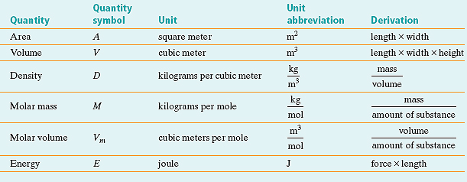
Derived Units
Combinations of SI base units form derived units.
  pressure is measured in kg/m•s², or pascals

Slide 18
Derived SI Units - Volume
Volume is the amount of space occupied by an object.
  The derived SI unit is cubic meters, m³
  The cubic centimeter, cm³, is often used
  The liter, L, is a non-SI unit
  1 L = 1000 cm³
  1 mL = 1 cm³

Slide 19
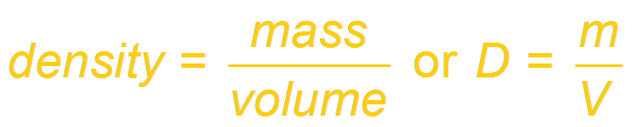
Derived SI Units - Density
Density is the ratio of mass to volume, or mass divided by volume.
  The derived SI unit is kilograms per cubic meter, kg/m³
  g/cm³ or g/mL are also used
  Density is a characteristic physical property of a substance.

Slide 20
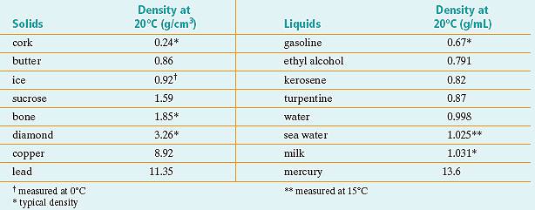
Derived SI Units – Density (continued)
Density can be used as one property to help identify a substance

Slide 21
SAMPLE PROBLEM
A sample of aluminum metal has a mass of 8.4 g. The volume of the sample is 3.1 cm³. Calculate the density of aluminum.
Given: mass (m) = 8.4 g
volume (V) = 3.1 cm³
Unknown: density (D)
Solution:

Slide 22
Aquarium Volume
What is the volume of an aquarium that is .18 m by 36 cm by 140 mm?
Volume = length x width x height
Step 1: convert all of the numbers to the same unit!
.18 m x 100 cm = 18 cm
1 m
140 mm x 1 cm = 14 cm
10 mm
V=18 x 14 x 36 = 9,072 cm³

Slide 23
Can You Do?
Perform density calculations.
Transform a statement of equality into a conversion factor.

Slide 24
Objectives 2.3
Distinguish between accuracy and precision.
Determine the number of significant figures in measurements.
Perform mathematical operations involving significant figures.
Convert measurements into scientific notation.
Distinguish between inversely and directly proportional relationships.

Slide 25
How to Measure
Measure 1 more than
your instrument is
marked….
EX:
whole - TENTHS
tenths - HUNDRETHS

Slide 26
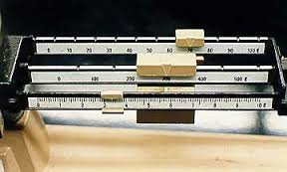
How to Measure Mass
Triple Beam Balance

Slide 27
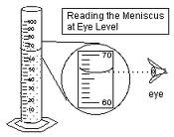
How to Measure Volume (liquid)
Graduated Cylinder

Slide 28
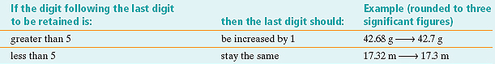
Rounding Rules

Slide 29
Significant Figures
Significant figures in a
measurement consist of all
the digits known with certainty
plus one final digit, which is
somewhat uncertain or is estimated.
The term significant
does not mean certain.

Slide 30
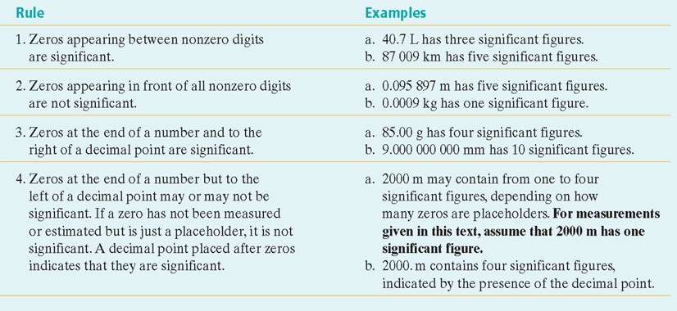
Significant Figure Rules

Slide 31
Significant Figures
Significant Figures
Rules
Example
All numbers count
Zero’s between numbers count
Leading zero’s don’t count
Zero’s at the end of a decimal count
Trailing zero’s don’t count
12.345
101.2
0.052
12.200
2000
5
4
2
5
1

Slide 32
Easier Way to Remember:
If decimal is PRESENT, start counting on the PACIFIC side (left) with the first nonzero #.
Examples:
12.345
101.2
0.052
12.200
If decimal is ABSENT, start counting on the ATLANTIC side (right) with the first nonzero #.
Examples:
200
5001

Slide 33
Practice Problems
Identify the number of significant figures:
5
3
3
3
4
4
2
2
3
3
3.0800
0.00418
7.09 x 10⁻⁵
91,600
0.003005
3.200 x 10⁹
250
780,000,000
0.0101
0.00800

Slide 34
Addition & Subtraction with Significant Figures
When adding or subtracting decimals, the answer must have the same number of digits to the right of the decimal point as there are in the measurement having the fewest digits to the right of the decimal point.
Example: 5.44 m - 2.6103 m
5.44 m - 2.6103 m = 2.8297 m
Final Answer = 2.83 m

Slide 35
Multiplication & Division with Significant Figures
For multiplication or division, the answer can have no more significant figures than are in the measurement with the fewest number of significant figures.
Example: 2.4 g/mL × 15.82 mL
2.4 g/mL × 15.82 mL = 37.968 g
Final Answer = 38 g

Slide 36
Scientific Notation
In scientific notation, numbers are written in the form M × 10^{n}, where the factor M is a number greater than or equal to 1 but less than 10 and n is a whole number.
Determine M by moving the decimal point in the original number to the left or the right so that only one nonzero digit remains to the left of the decimal point.
Determine n by counting the number of places that you moved the decimal point. If you moved it to the left, n is positive. If you moved it to the right, n is negative.

Slide 37
Scientific Notation (continued)
  example: 0.000 12 mm
Step one….. Find M by moving the decimal
0.000 12 mm M=1.2 mm
Step two….. Find n by counting how far you moved the decimal (left =positive; right = negative)
4 to the left….. n=-4
Final Answer….. 1.2 x 10⁻⁴ mm

Slide 38
Sample Problem (continued)
The density unit is g/cm3, and the mass unit is kg.
conversion factor: 1000 g = 1 kg
Rearrange the density equation to solve for volume.
Mass 3.057 kg x 1000 g = 3057 g
1 kg
2.70 g/cm³ = 3057 g
V
V = 1132.222 cm³
V = 1.13 × 10³ cm³

Slide 39
Can You Do????
Distinguish between accuracy and precision.
Determine the number of significant figures in measurements.
Perform mathematical operations involving significant figures.
Convert measurements into scientific notation.
Distinguish between inversely and directly proportional relationships.

Slide 40
Sample Problem…
Putting it all together!
Calculate the volume of a sample of aluminum
that has a mass of 3.057 kg. The density of
aluminum is 2.70 g/cm3.
Given: mass = 3.057 kg, density = 2.70 g/cm3
Unknown: volume of aluminum
WHAT do you need to do…..
- mass units are different!!!
- how can we use this information to solve for volume?!

Slide 41
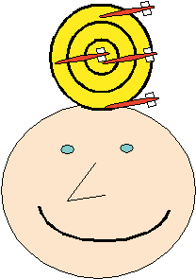
Accuracy
Accuracy refers to the closeness
of measurements to the correct or
accepted value of the quantity
measured.

Slide 42
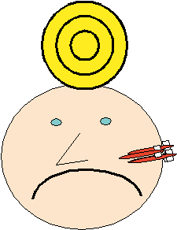
Precision
Precision refers to the
closeness of a set of
measurements of the same
quantity made in the same way.

Slide 43
Explain in terms of accuracy & precision

Slide 44
Percent Error
Percentage error is calculated by subtracting the accepted value from the experimental value, dividing the difference by the accepted value, and then multiplying by 100.

Slide 45
Sample Problem
A student measures the mass and volume of a substance and calculates its density as 1.40 g/mL. The correct, or accepted, value of the density is 1.30 g/mL. What is the percentage error of the student’s measurement?

Slide 46
Directly Proportional
&
Inversely Proportional
Two quantities are directly proportional to each other if dividing one by the other gives a constant value
Two quantities are inversely proportional to each other if their product is constant

Slide 47
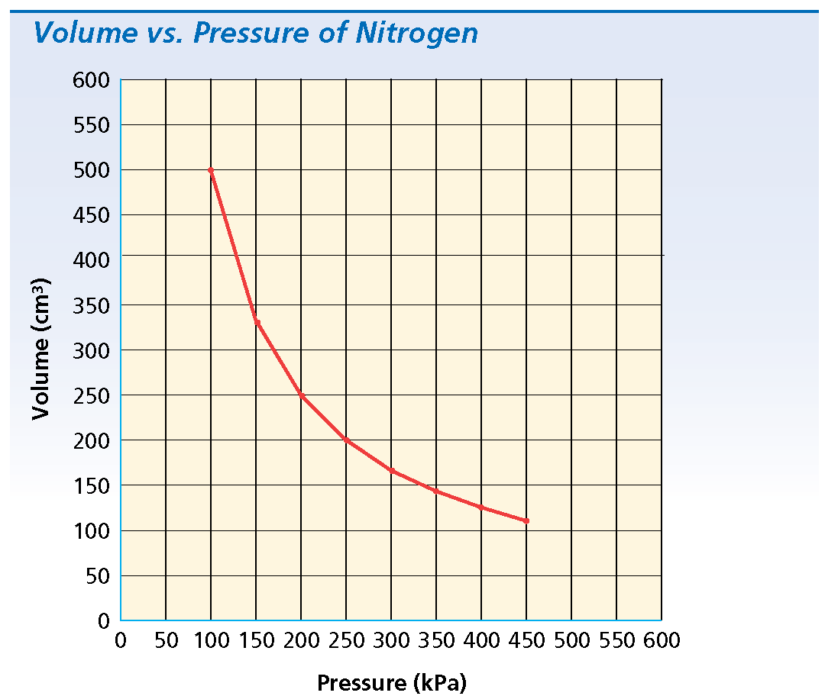
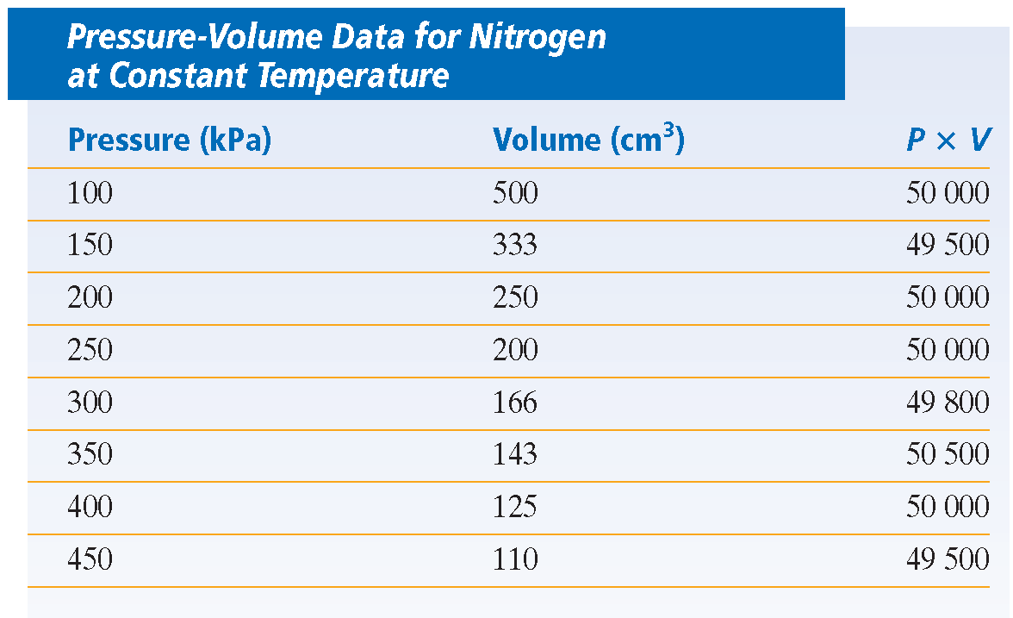
Direct or
Inverse?
INVERSE

Slide 48
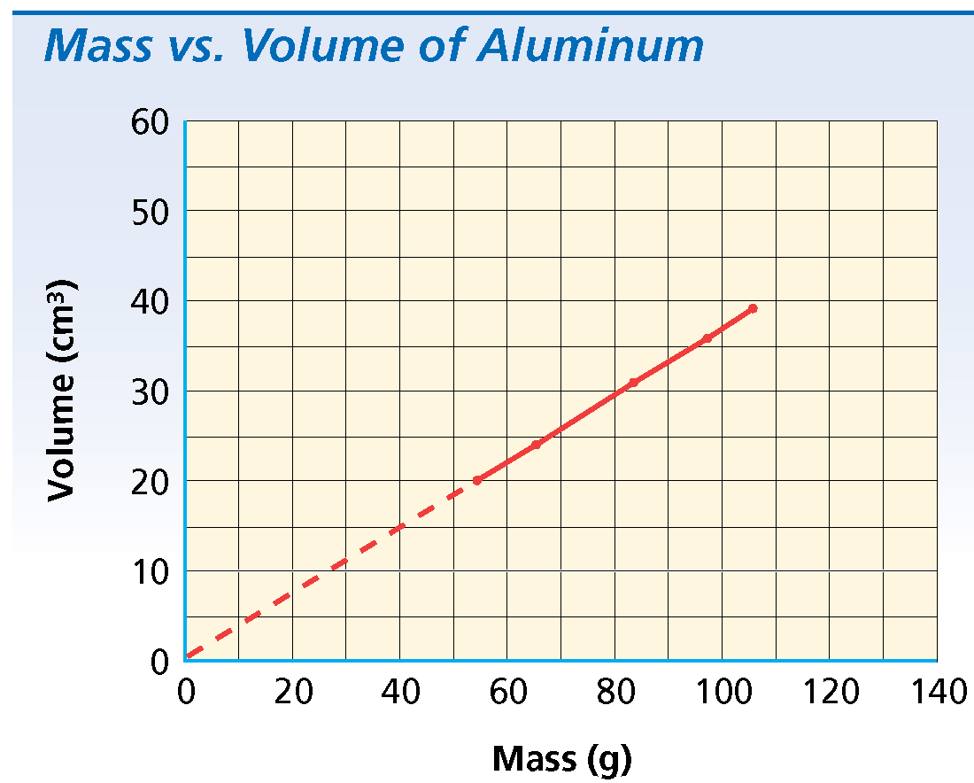
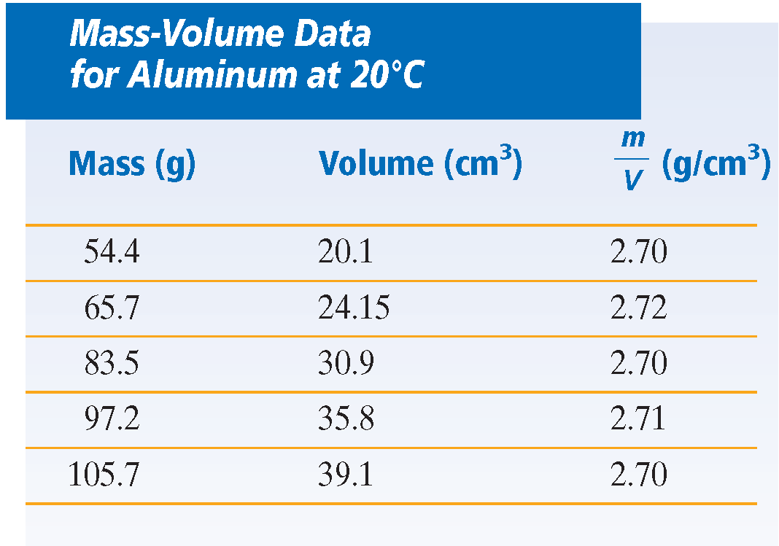
Direct or
Inverse?
DIRECT

