Slide 1
Matter & Change
Chapter 1
Why it Matters Video

Slide 2
Objectives for 1.1
Define Chemistry

Slide 3
Definition of Chemistry
Chemistry is the study of the:
  composition, structure, and properties of matter,
  the processes that matter undergoes,
  and the energy changes that accompany these processes

Slide 4
Can you do it????
Define Chemistry

Slide 5
Objectives 1.2
Distinguish between the physical properties and chemical properties of matter.
Classify changes of matter as physical or chemical.
Explain the gas, liquid, and solid states in terms of particles.
Explain how the law of conservation of energy applies to changes in matter.
Distinguish between a mixture and a pure substance.

Slide 6
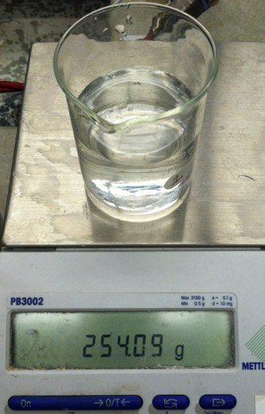
Matter
Matter is anything that has mass and volume.
Volume is the amount of three dimensional space an object occupies. (takes up space)
Mass is a measure of the amount of matter.

Slide 7
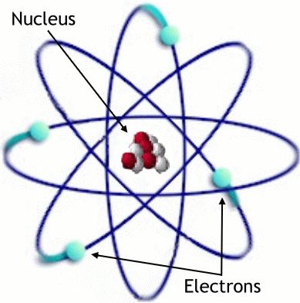
Basic Building Blocks of Matter
An atom is the smallest unit of an element that maintains the chemical identity of that element.
For example: if the element
is flammable then one atom
of that element will also be
flammable.
If broken into its smaller
parts then the property no
longer remains the same.

Slide 8
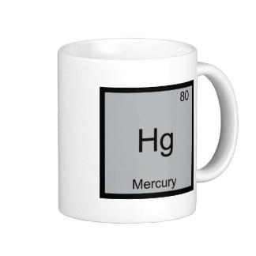
Basic Building Blocks of Matter (continued)
An element is:
  a pure substance that cannot be broken down into simpler, stable substances
  made of one type of atom.
  Found on the periodic table

Slide 9
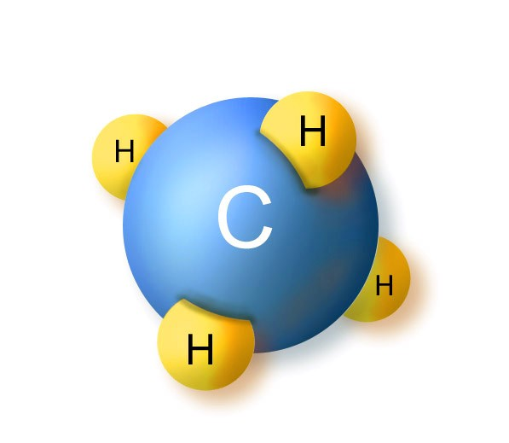
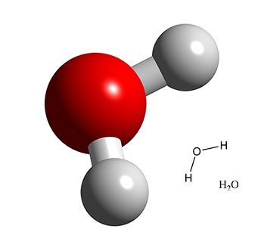
Basic Building Blocks of Matter (continued)
A compound is:
  a substance that can be broken down into simple stable substances.
  Each compound is made from the atoms of two or more elements that are chemically bonded.

Slide 10
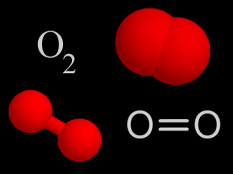
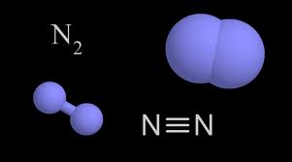
Basic Building Blocks of Matter (continued)
A molecule is:
  a substance that can be broken down into simple stable substances.
  Each molecule is made from the two or more atoms of the same element that are chemically bonded.

Slide 11
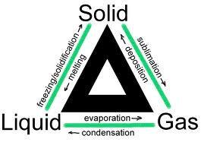
States of Matter
A change of state is a physical change of a substance from one state to another.
states of matter—solid state, liquid state, gas state, plasma

Slide 12
States of Matter (continued)
In the solid state, matter has definite volume and definite shape.
In the liquid state, matter has a definite volume but an indefinite shape.
In the gas state, matter has neither definite volume nor definite shape.
Plasma is a high-temperature physical state of matter in which atoms lose most of their electrons, particles that make up atoms.

Slide 13
Properties and Changes in Matter
  volume
  mass
  the amount of energy in a substance.
  melting point
  boiling point
  density
  ability to conduct electricity
  ability to transfer energy as heat

Slide 14
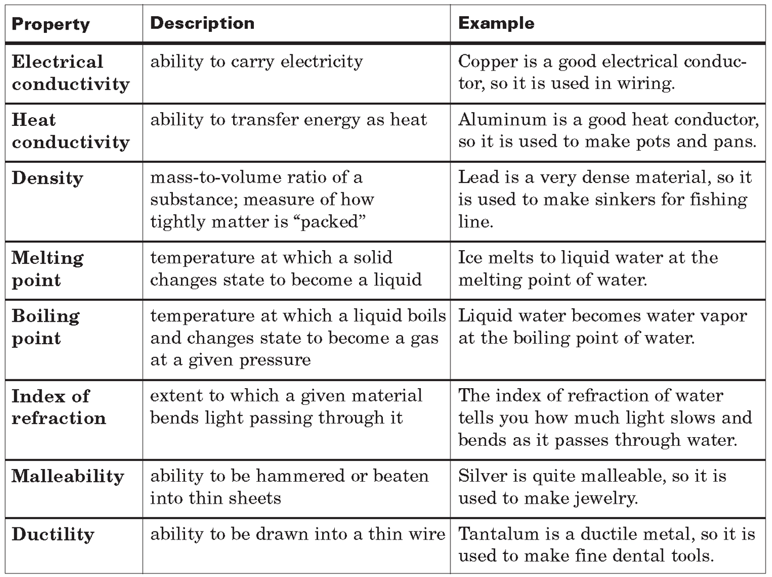
Properties of Matter

Slide 15
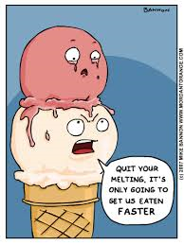
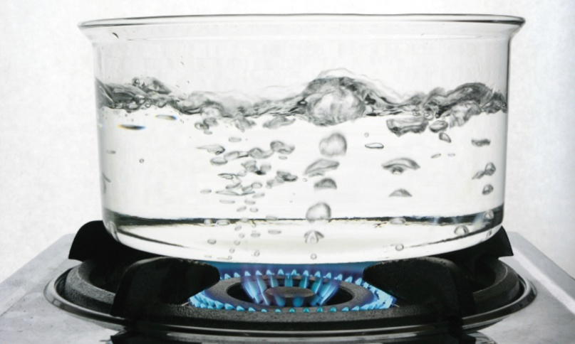
Physical Properties & Physical Changes
A physical property is a characteristic that can be observed or measured without changing the
identity of the substance.
  melting point and boiling point
A physical change is a change in a
substance that does not involve a change in
the identity of the substance.
  grinding, cutting, melting, and boiling

Slide 16
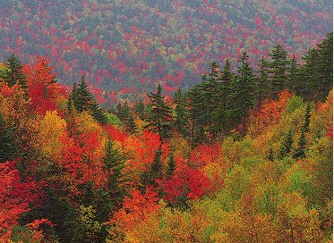
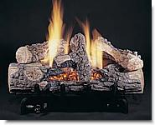
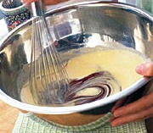
Chemical Properties & Chemical Changes
A chemical property relates to a substance’s ability to undergo changes that transform it into different substances
A change in which one or more substances are converted into different substances is called a chemical change or chemical reaction.

Slide 17
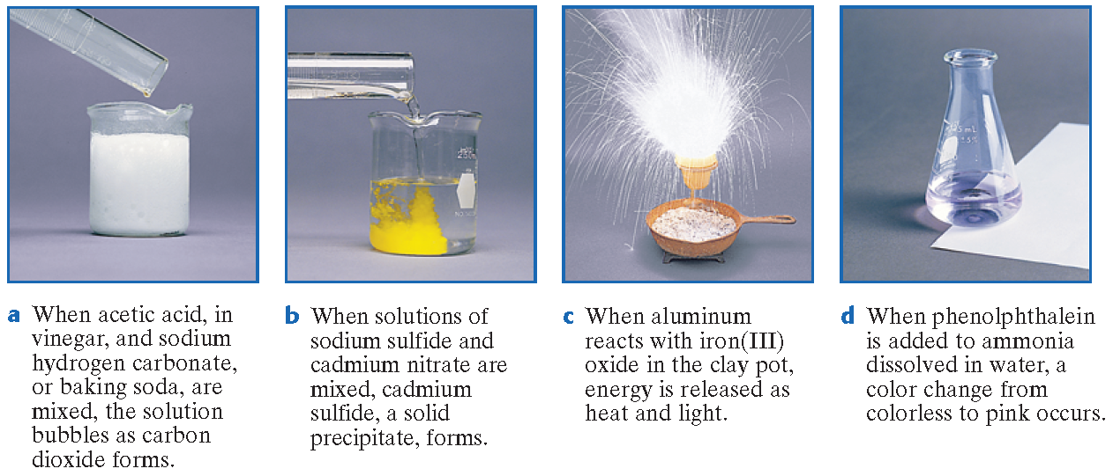
Evidence of a Chemical Change

Slide 18
Physical/Chemical Change Song
Change

Slide 19
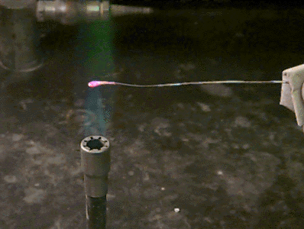
A piece of copper wire is heated in a bunsen burner causes the copper wire to change color.
Physical – Hint: COLOR
Physical or Chemical??

Slide 20
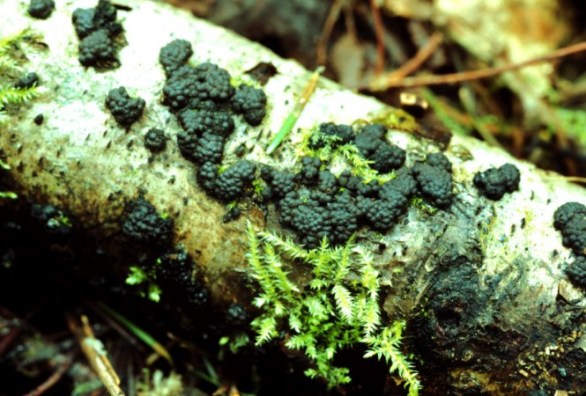
Decaying Wood…
Chemical – Hint: Decay
Physical or Chemical??

Slide 21
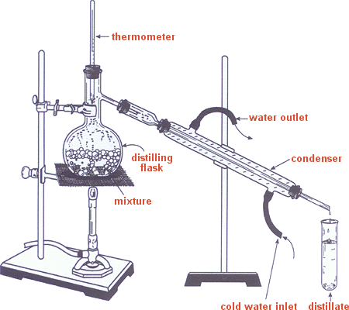
Distillation
Distillation is a method for separating mixtures based on different boiling points.
Question: Is this a chemical or physical process?
Physical because you are not changing the chemical formula of the material! It’s just changing state!

Slide 22
Parts of a Chemical Reaction
The reactants are the substances that react in a chemical change.
The products are the substances that are formed by the chemical change.
reactants product
Carbon plus oxygen yields (or forms) carbon dioxide.
carbon + oxygen carbon dioxide

Slide 23
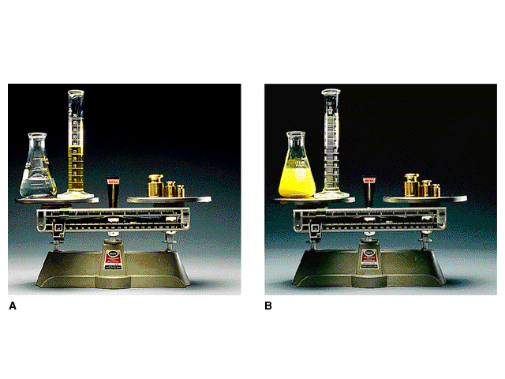
Law of Conservation of Mass
In a chemical reaction, the mass of the products equals the mass of the reactants.

Slide 24
Energy and Changes in Matter
Energy is always involved when physical or chemical changes occur.
Energy can be in various forms.
  heat
  light
Energy can be absorbed or released in a change, it is not destroyed or created.
  law of conservation of energy

Slide 25
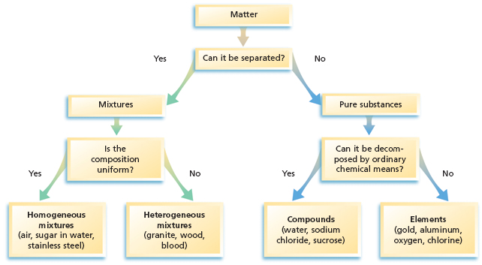
Classification of Matter

Slide 26
Classification of a Mixture
A mixture is a blend of two or more kinds of matter, each of which retains its own identity and properties.
  mixed together physically
  can usually be separated
Homogeneous mixtures are called solutions
  uniform in composition (salt-water solution)
Heterogeneous mixtures
  not uniform throughout (clay-water mixture)

Slide 27
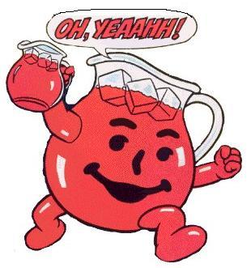
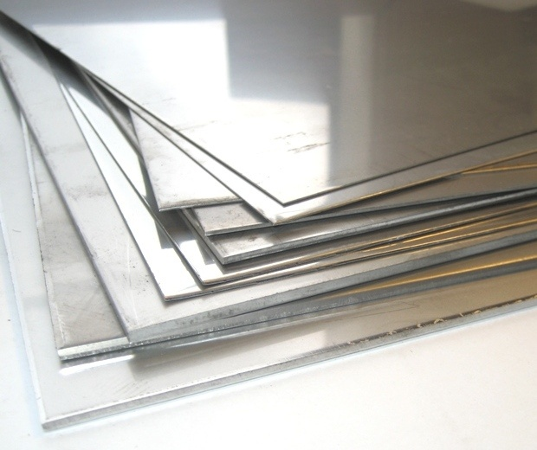
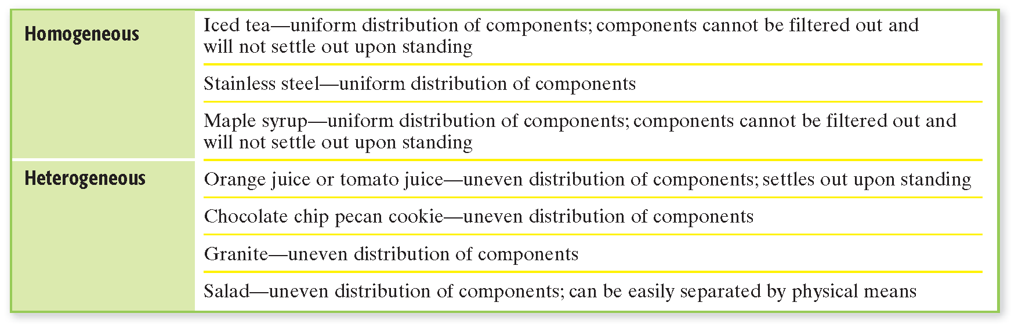
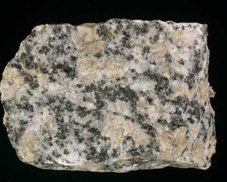
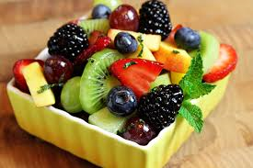
Examples of Mixtures

Slide 28
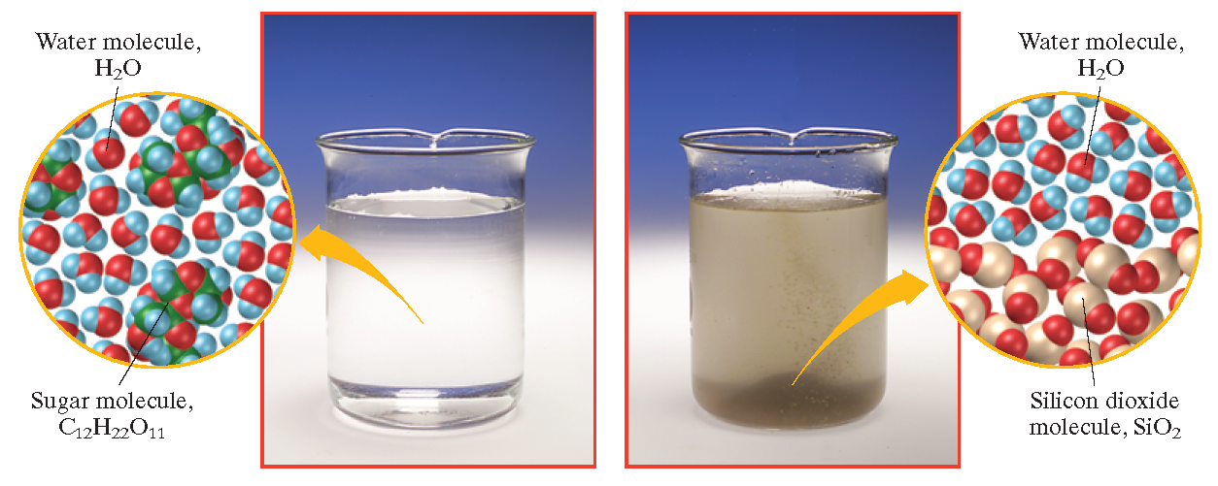
Types of Mixtures

Slide 29
Pure Substance
A pure substance has a fixed composition.
Pure substances are either compounds or elements.
A pure substance differs from a mixture in the following ways:
  Every sample of a given pure substance has exactly the same characteristic properties.
  Every sample of a given pure substance has exactly the
  same composition.
  Water is always 11.2% hydrogen and 88.8% oxygen
  by mass.

Slide 30
Can you do this???
Distinguish between the physical properties and chemical properties of matter.
Classify changes of matter as physical or chemical.
Explain the gas, liquid, and solid states in terms of particles.
Explain how the law of conservation of energy applies to changes in matter.
Distinguish between a mixture and a pure substance.

